Slide 1
Data-efficient Learning of Aircraft Dynamics for Simulated Flight Testing

Slide 2
Contents
Introduction
Boeing 747 Simulator
2.1 Data Explanation
2.2 ML Models Trained
2.3 Qualitative Results with Control Inputs
2.4 Quantitative Results
Bell 412 State Space model
3.1 Visualization of 2-3-1-1
Bell 205 Data Exploration
Filtering Experiment
Models Trained
Inference
Future work and questions

Slide 3

1. Introduction
Certification requirements for aeronautical products often entail extensive flight testing.
Predictive models that simulate aircraft behaviour based on historical flight data.
Enabling the creation of virtual test environments, reducing the need for physical flight test hours.
“Use once, test many times and in many ways”
Minimize the carbon footprint of flight testing.
Expedite the development process, fostering innovation and the creation of superior, environmentally friendly aircraft.
Notes:
Talk about: Introducing a

Slide 4
Contents
Introduction
Boeing 747 Simulator
2.1 Data Explanation
2.2 ML Models Trained
2.3 Qualitative Results with Control Inputs
2.4 Quantitative Results
Bell 412 State Space model
3.1 Visualization of 2-3-1-1
Bell 205 Data Exploration
4.1 Filtering Experiment
4.2 Models Trained
4.3 Inference and Results
Future work and questions

Slide 5
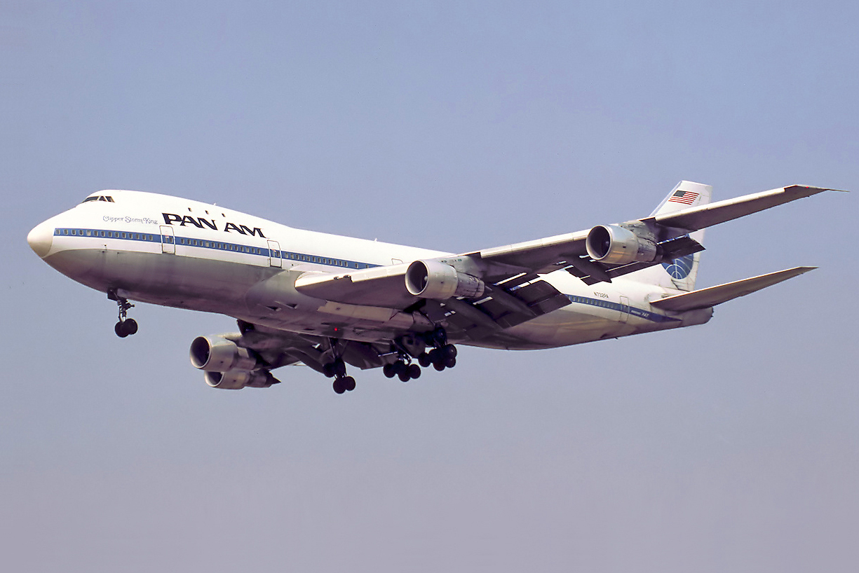
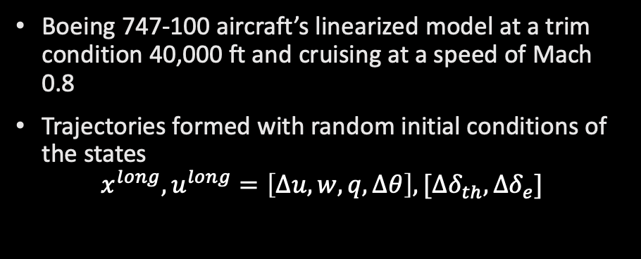
2. Boeing 747 Simulator
Boeing 747-100 aircraft’s linearized model at a trim condition 40,000 ft and cruising at a speed of Mach 0.8
Trajectories formed with random initial conditions of the states
$$x^{long},u^{long}=\left[∆u, w, q, ∆θ\right], [{∆δ}_{th}, {∆δ}_{e}]$$
Fig: Boeing 747 – 100

Slide 6




2.1 Data Explanation
$${∆δ}_{e}^{phug}= \left\{\begin{aligned}c if 20≤t≤29 \\ −c if 10≤t≤19 \\ 0 otherwise\end{aligned}\right.$$
${∆δ}_{th}$=0, the thrust input is kept constant at 0
${∆δ}_{e}$ (Elevator input), takes sinusoidal, step, phugoid, step and 0.
$${∆δ}_{e}^{sin}= \left\{\begin{aligned}c\sin\left(t\right) if 10≤t≤30 \\ 0 otherwise\end{aligned}\right.$$
$${∆δ}_{e}^{step}= \left\{\begin{aligned}c if t \% 100<20 \\ 0 otherwise\end{aligned}\right.$$

Slide 7
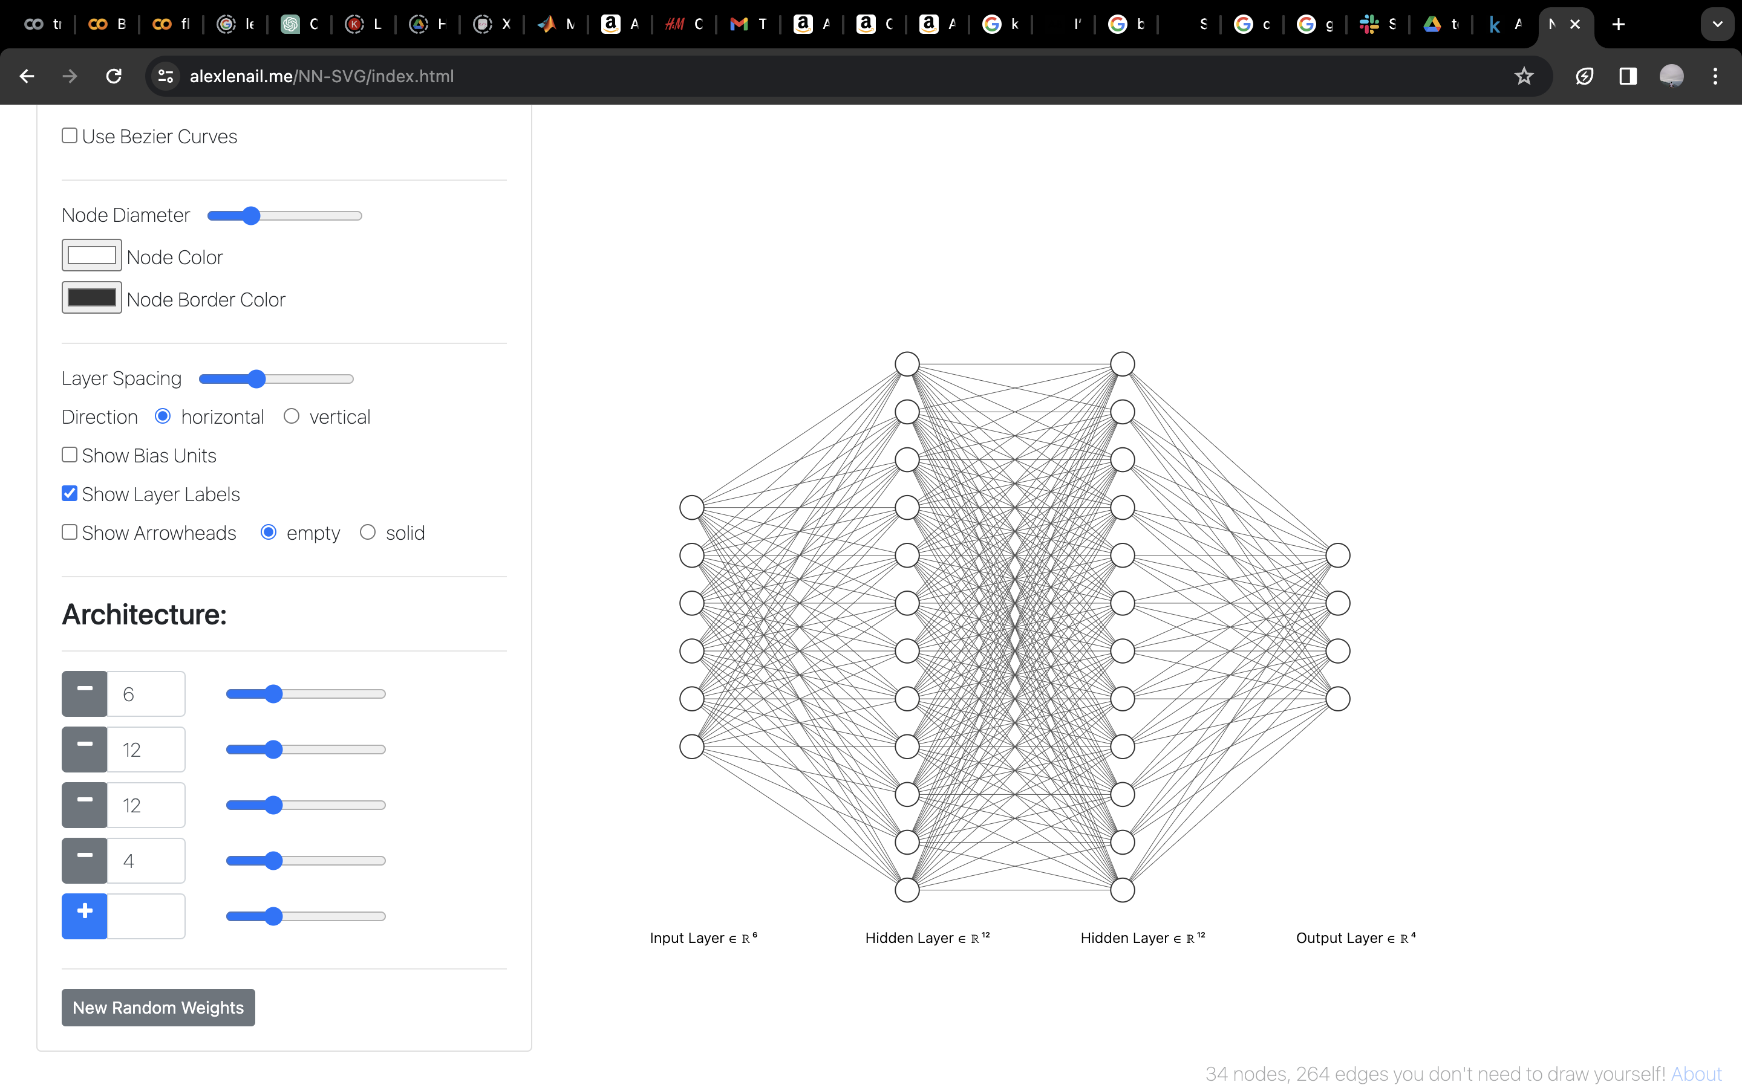









2.2 ML Models Trained
$$X=\left[∆u, w, q, ∆θ,{∆δ}_{th}, {∆δ}_{e}\right]$$
$$x=\left[∆u, w, q, ∆θ\right]$$
Neural Network
LSTM
LSTM 4 Layers
FC Layer
$$X(t)$$
$$X(t)$$
$$x(t+1)$$
$$X(t−1)$$
$$X(t−2)$$
$$x(t+1)$$
$$X(t−3)$$
$$X(t−4)$$

Slide 8



2.2 ML Models Trained
$$X=\left[∆u, w, q, ∆θ,{∆δ}_{th}, {∆δ}_{e}\right]$$
$$x=\left[∆u, w, q, ∆θ\right]$$
Neural Network
LSTM
${\hat{x}}_{t+1}=f_{ω}(X_{t})$
Loss Function:
$L=\frac{1}{N}\sum_{i}^{N}{{|x_{t+1}^{i} − {\hat{x}}_{t+1}^{i}|}^{2}}$
Weight Update:
$ω_{old}=ω_{old}−λ\frac{∂L}{∂ω_{old}}$
Here $λ$ is the learning rate.
Optimizer: Adam
$${\hat{x}}_{t+1}= g_{φ}(X_{t}, X_{t−1},X_{t−2},X_{t−3}, X_{t−4})$$
Loss Function:
$L_{lstm}=\frac{1}{N}\sum_{i}^{N}{{|x_{t+1}^{i} − {\hat{x}}_{t+1}^{i}|}^{2}}$
Weight Update:
$φ_{old}=φ_{old}−λ\frac{{∂L}_{lstm}}{∂φ_{old}}$
Here $λ$ is the learning rate.
Optimizer: Adam

Slide 9
2.2 ML Models Trained
LSTM | MLP 1 | MLP 2
Layers = 4, Hidden_size = 10, | Layers = 8, Hidden_size = 100, | Layers = 8, Hidden_size = 32,
Epochs = 500, batch_size = 256, lr = 0.005 (Reduce LR on plateau used) | Epochs = 400 , batch_size = 256, lr = 0.005 | Epochs = 400, batch_size = 256, lr = 0.005

Slide 10
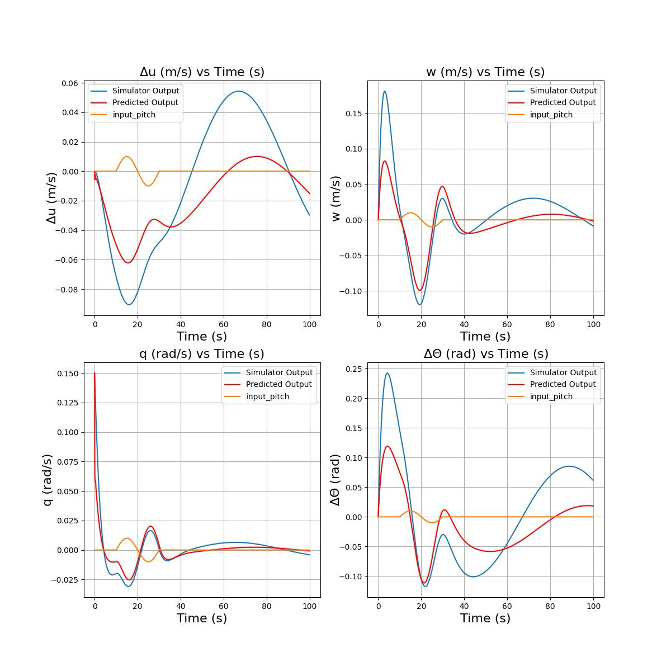
2.3 Qualitative Analysis Sinusoidal Input (LSTM) RMSE = 0.0011 Every qualitative analysis was conducted using auto regressive approach, that is , the model’s outputs are fed back into the model as inputs for the next time step.

Slide 11
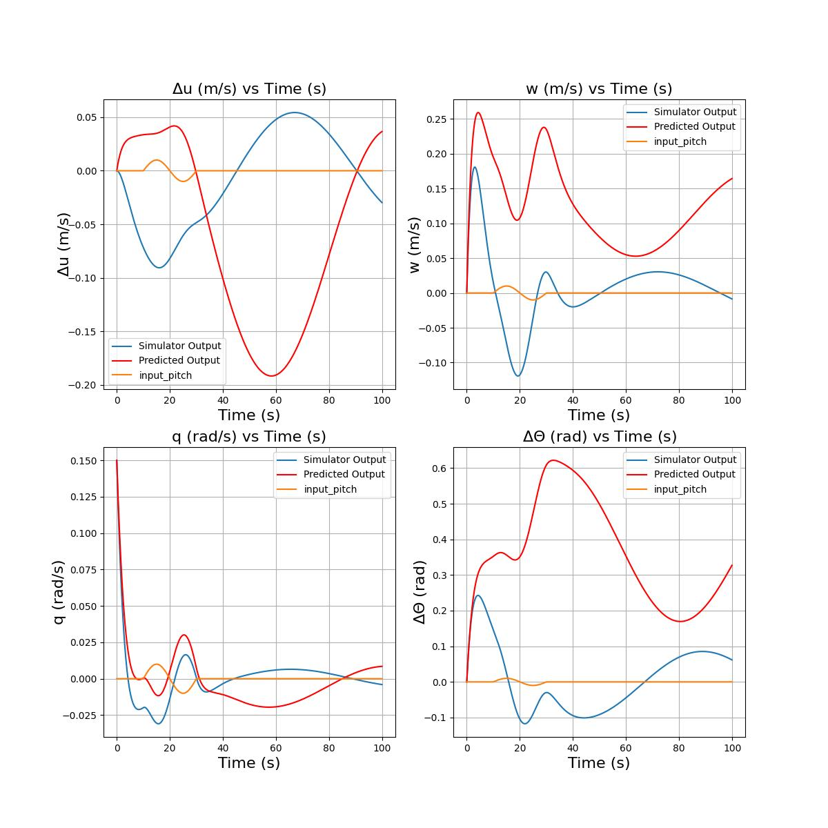
2.3 Qualitative Analysis (Sinusoidal)
MLP1 (100 HS) RMSE: 0.176
MLP2 (32 HS) RMSE: 0.04

Slide 12
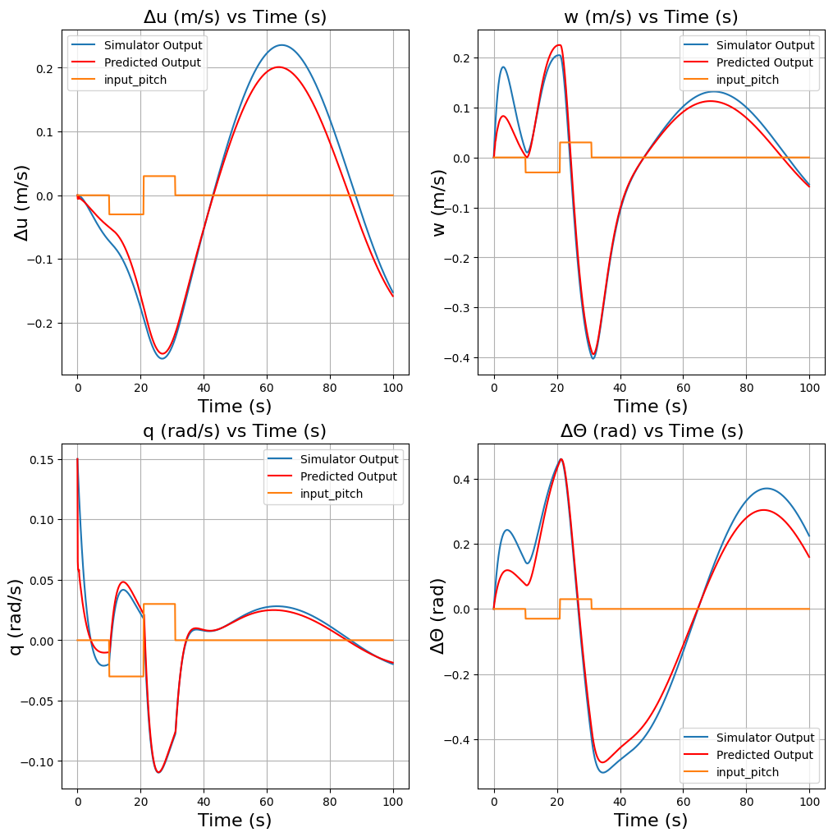
2.3 Qualitative Analysis Phugoid Input (LSTM) RMSE = 0.001

Slide 13
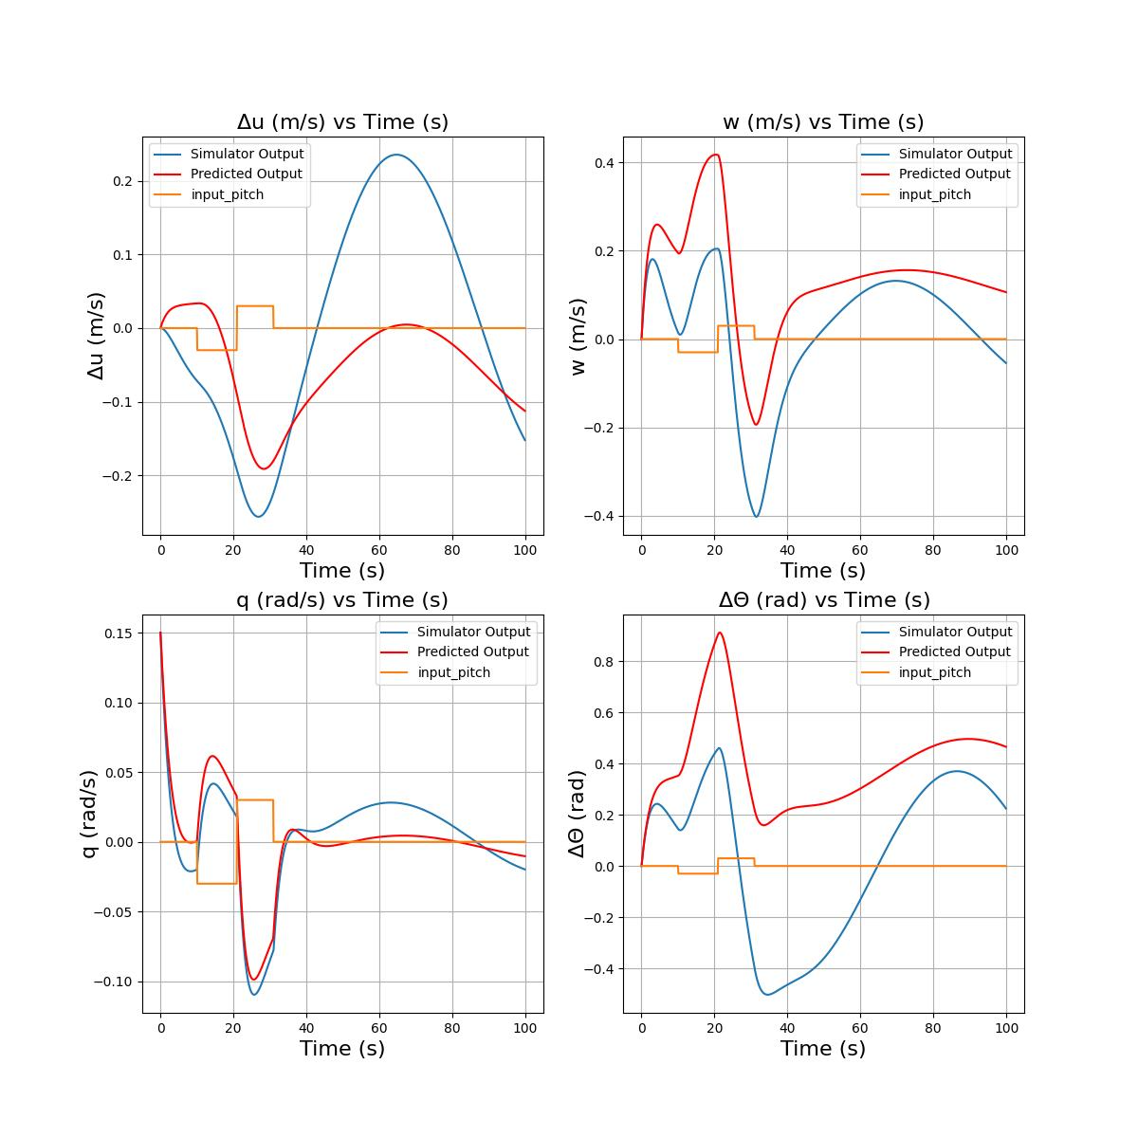
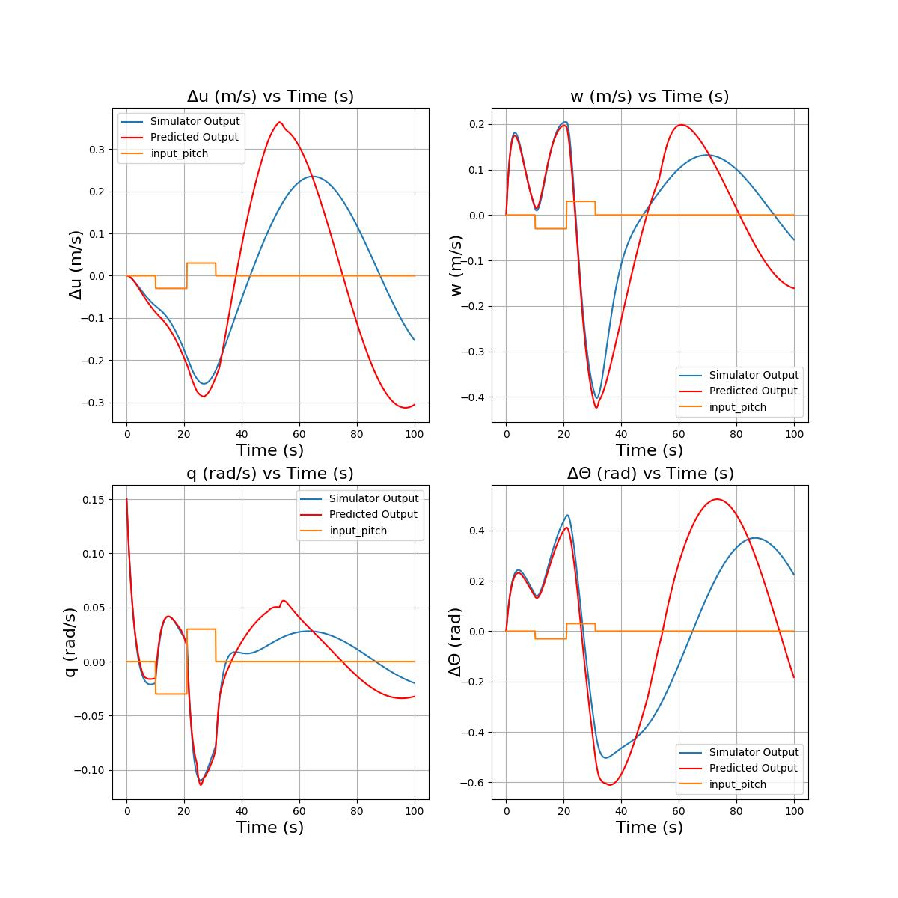
2.3 Qualitative Analysis (Phugoid)
MLP1 (100 HS) RMSE: 0.174
MLP2 (32 HS) RMSE: 0.04

Slide 14
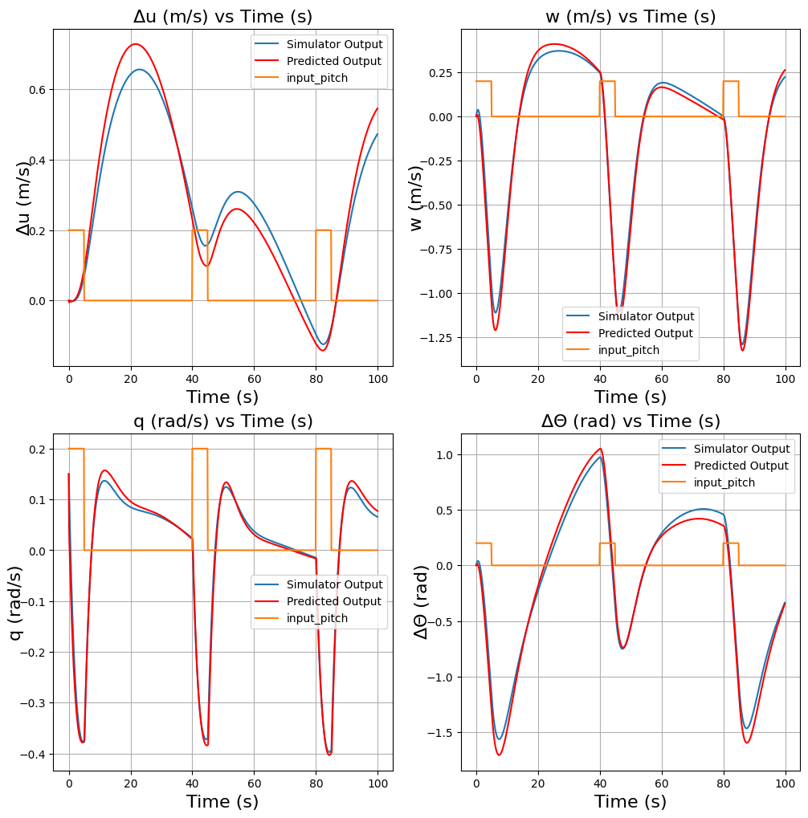
2.3 Qualitative Analysis Step Input (LSTM) RMSE = 0.0026

Slide 15
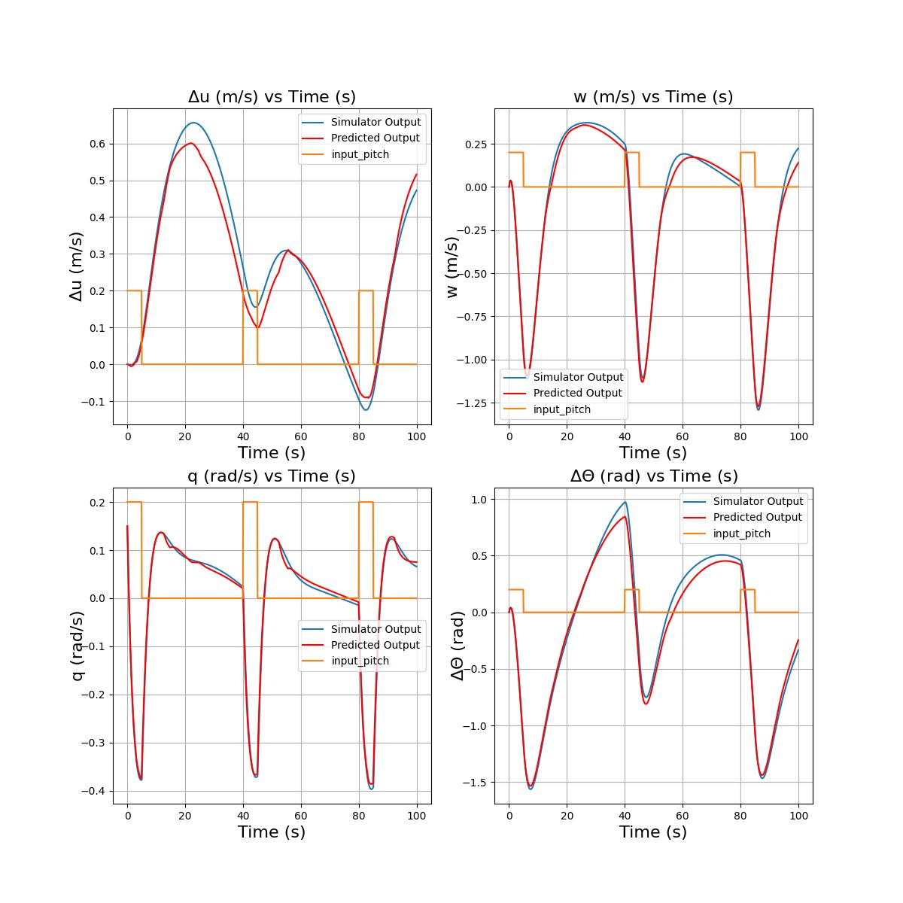
2.3 Qualitative Analysis (Step)
MLP2 (32 HS) RMSE: 0.041
MLP1 (100 HS) Produces High values so testing crashes
With the state [0, 0, 0.15, 0]

Slide 16
2.4 Quantitative Analysis
Used 100 trajectories of 100 second (same random initial conditions from the distribution within the domain for all the model) with equal distributions of all the control profiles
Model | RMSE Standard Deviation | RMSE Average
LSTM | 0.019 | 0.015
MLP 2 (32 HS) | 0.1199 | 0.028
MLP 1 (100 HS) (without step input) | 0.233 | 0.007

Slide 17
Inference
LSTM model seems to outperform MLP here due to the different type of inputs to the model
In MLP higher the size of hidden layer, lower the Accuracy

Slide 18
Contents
Introduction
Boeing 747 Simulator
2.1 Data Explanation
2.2 ML Models Trained
2.3 Qualitative Results with Control Inputs
2.4 Quantitative Results
Bell 412 State Space model
3.1 Visualization of 2-3-1-1
Bell 205 Data Exploration
Filtering Experiment
Models Trained
Inference
Future work and questions

Slide 19
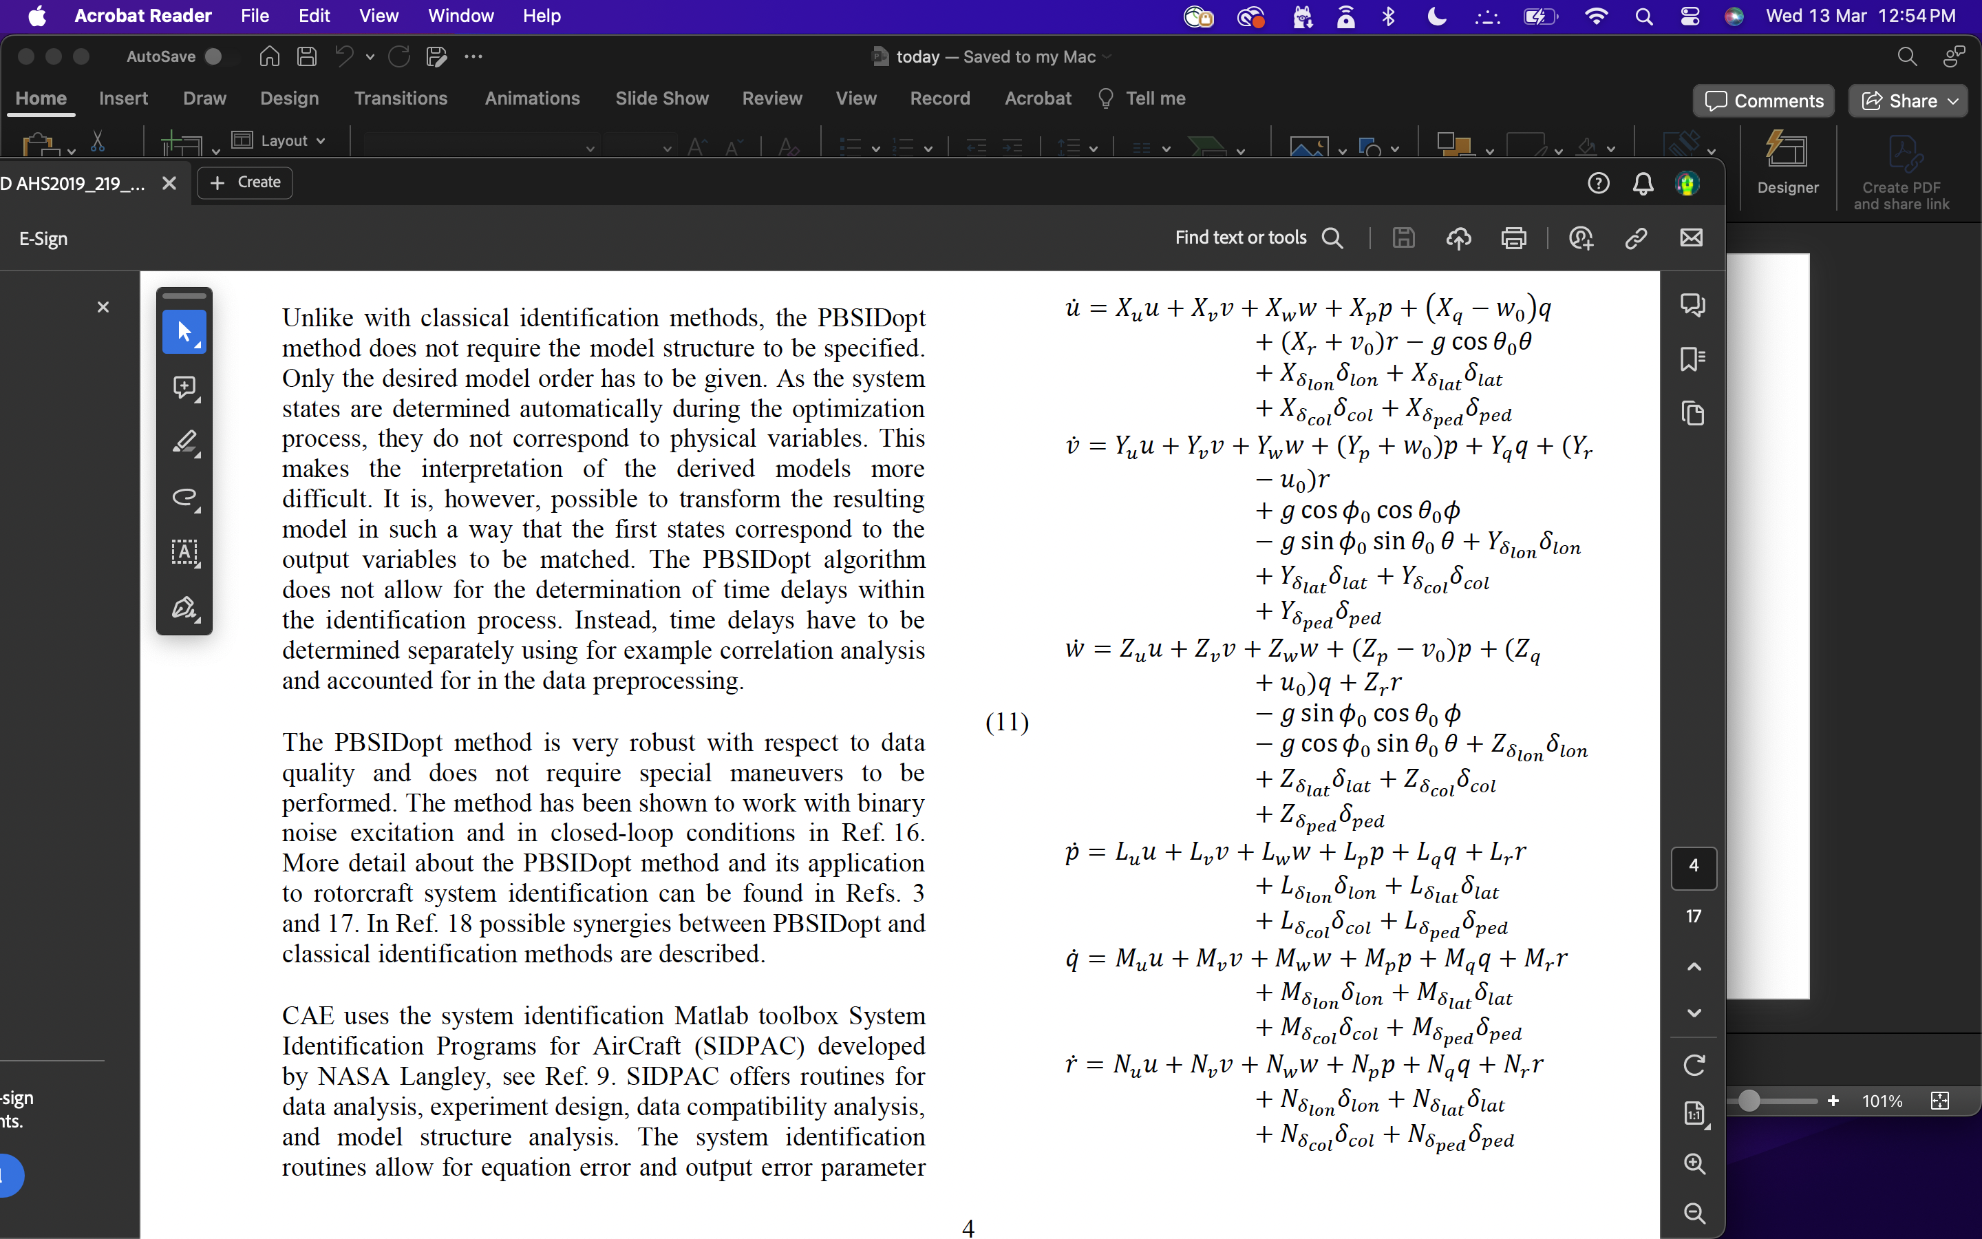

4. Bell 412 State Space Model
State Space variables^{[1]}:
$$x=[p, q, r, u, v, w]$$
Control Variables^{[1]}:
$$u=\left[{∆δ}_{ped}, {∆δ}_{col},{∆δ}_{lat}, {∆δ}_{lon}, φ,θ\right]$$
State Space Equations derived from 6 DoF Equations of motion^{[1]}:
$$\dot{x}=Ax+Bu$$
Used the stability and control derivative from NRC Approach^{[1]}
Created State space equations using the Equation in the left
Assumed, $φ_{0}=0, θ_{0}=0.1$radians
Runge Kutta Method for integration of the states
6 DoF Equations of motion^{[1]}
[1] Seher-Weiss, Susanne & Greiser, Steffen & Wartmann, Johannes & Gubbels, Arthur & Ricciardi, Joseph & Hui, Kenneth. (2019). Bell 412 System Identification: Comparing Methods and Tools. 10.4050/F-0075-2019-14636.

Slide 20
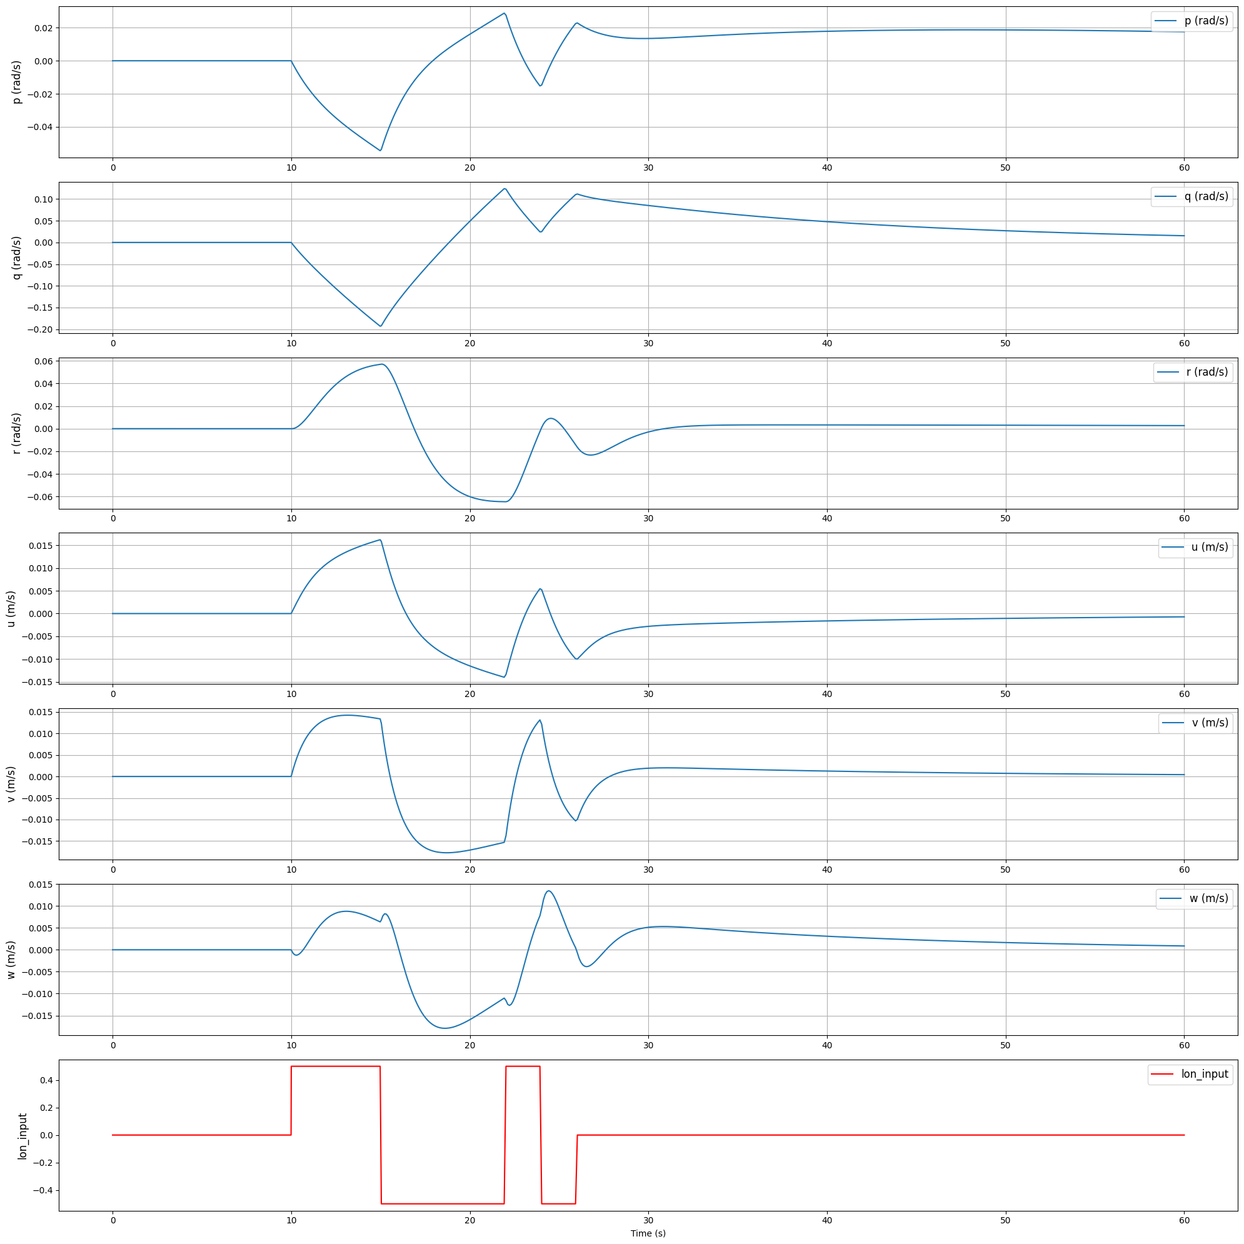
2-3-1-1 Longitudinal input

Slide 21
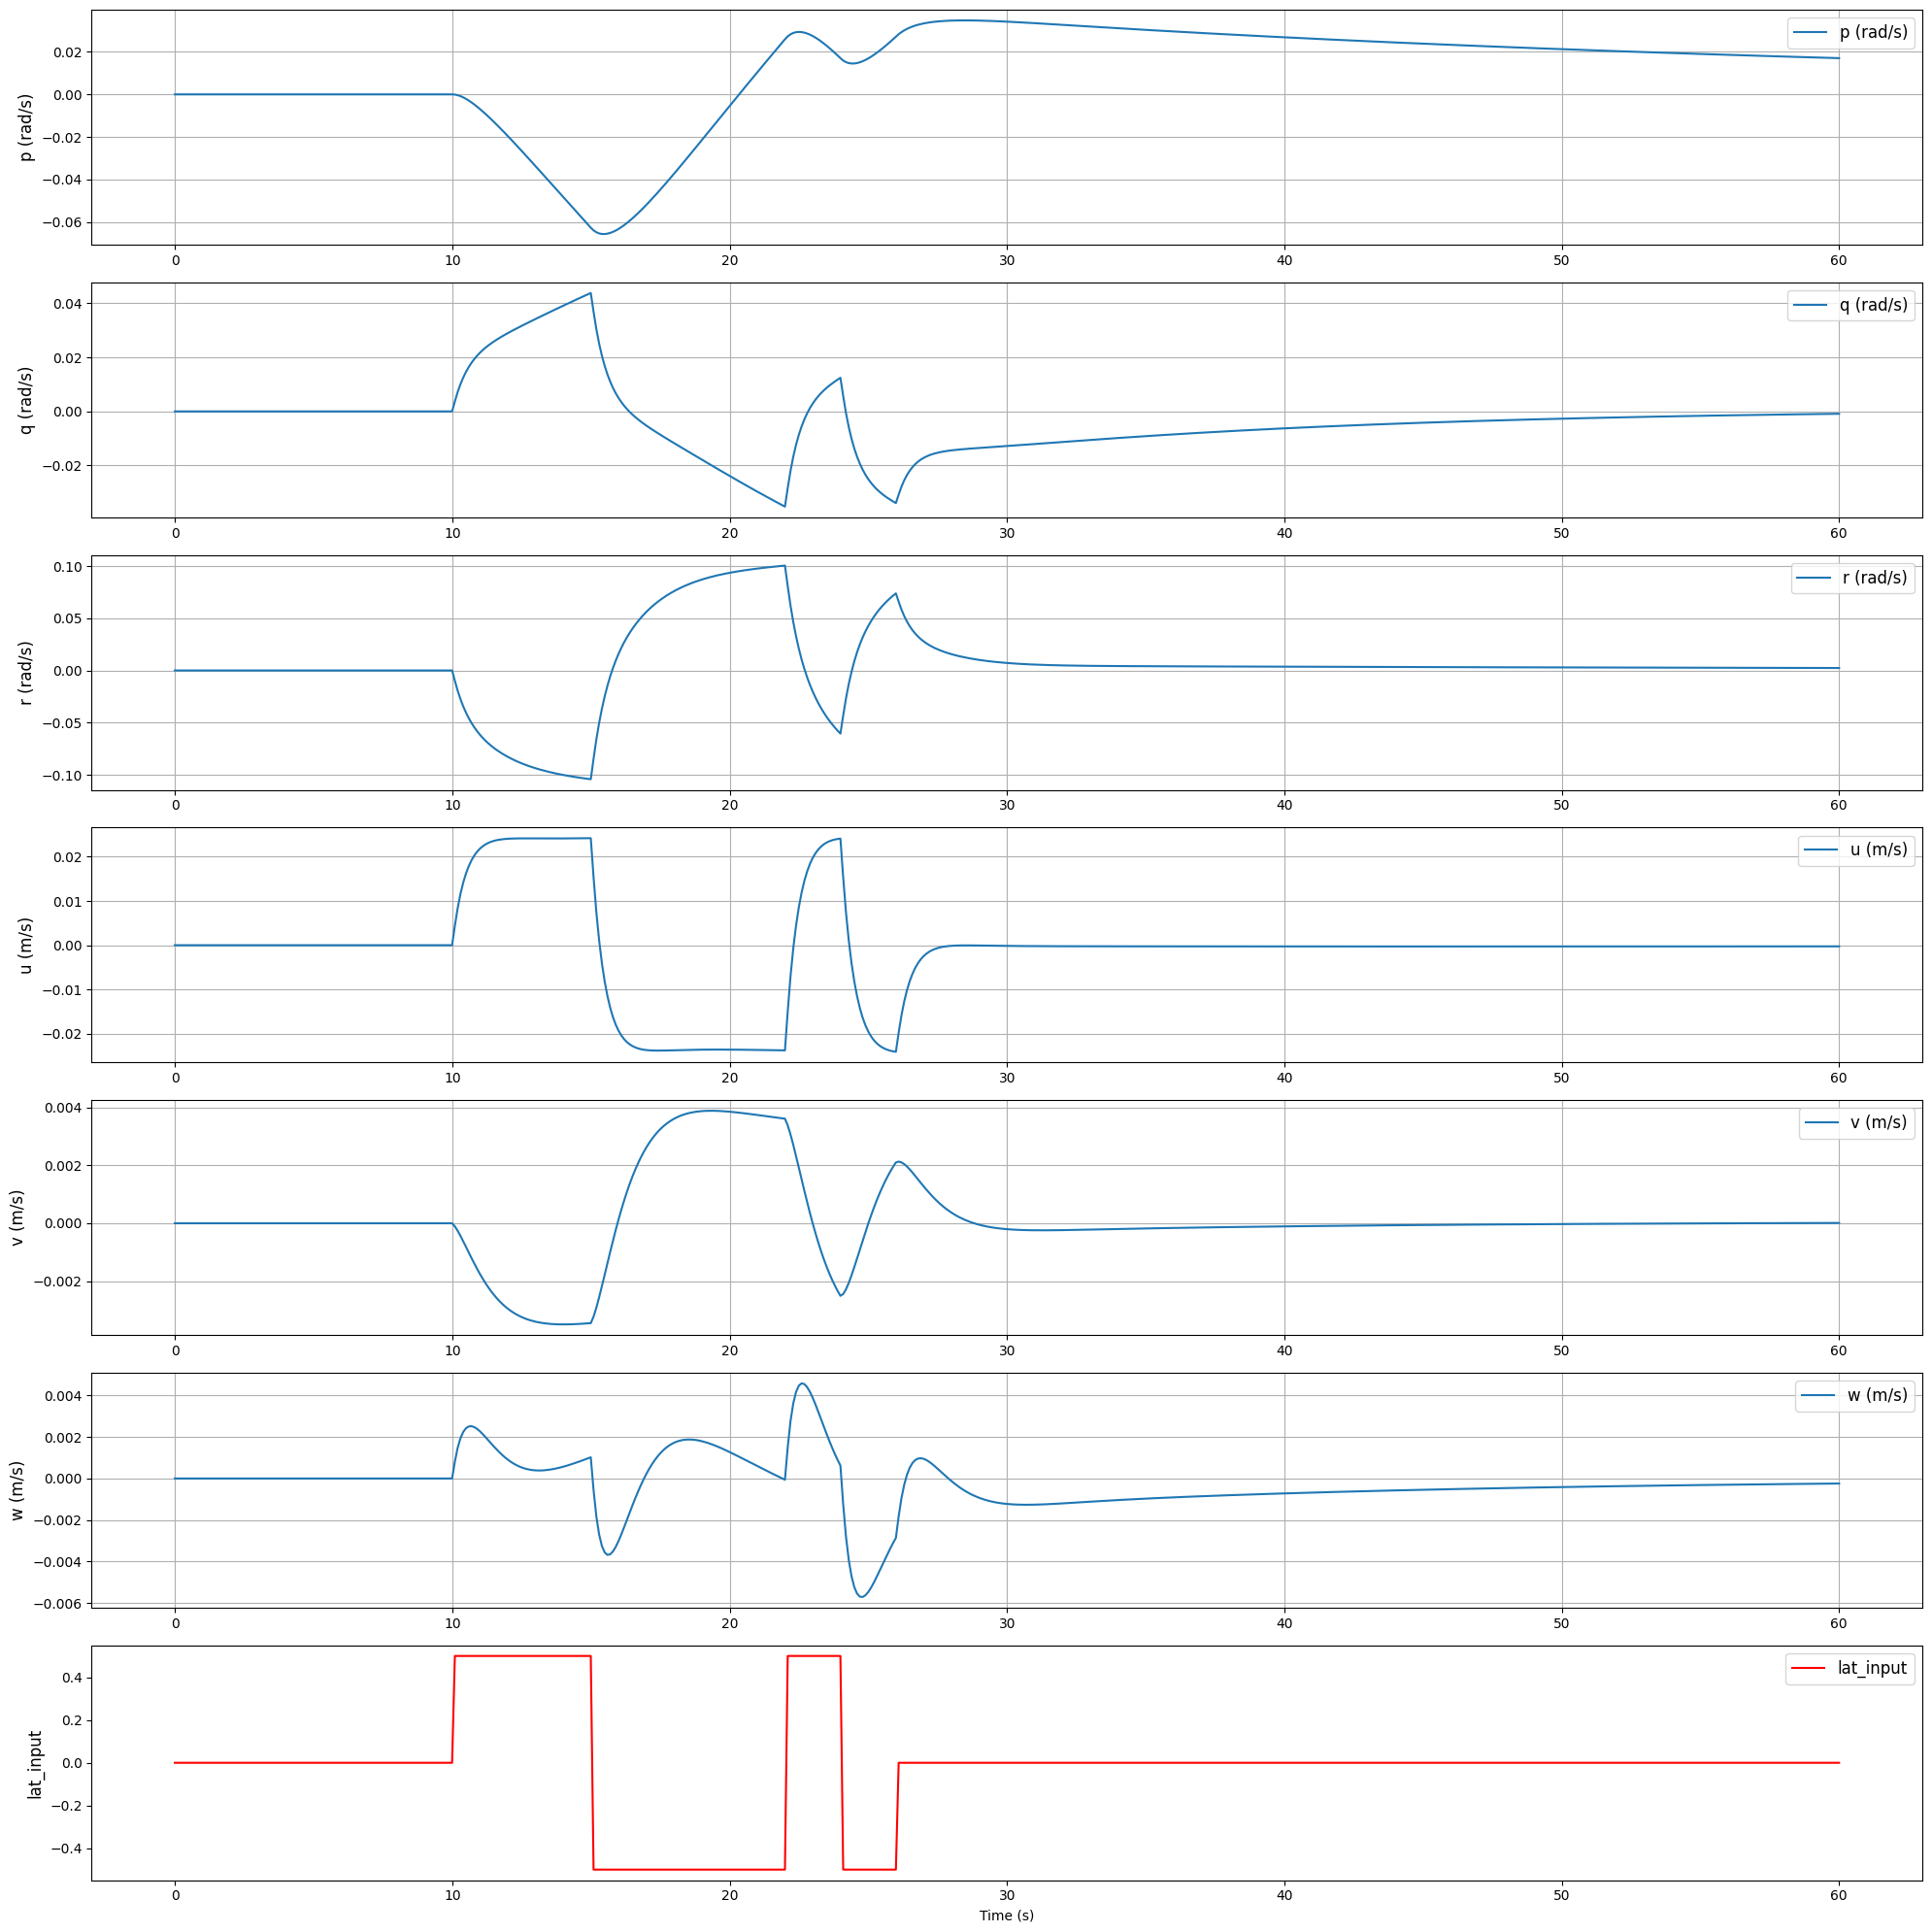
2-3-1-1 Latitudinal input

Slide 22
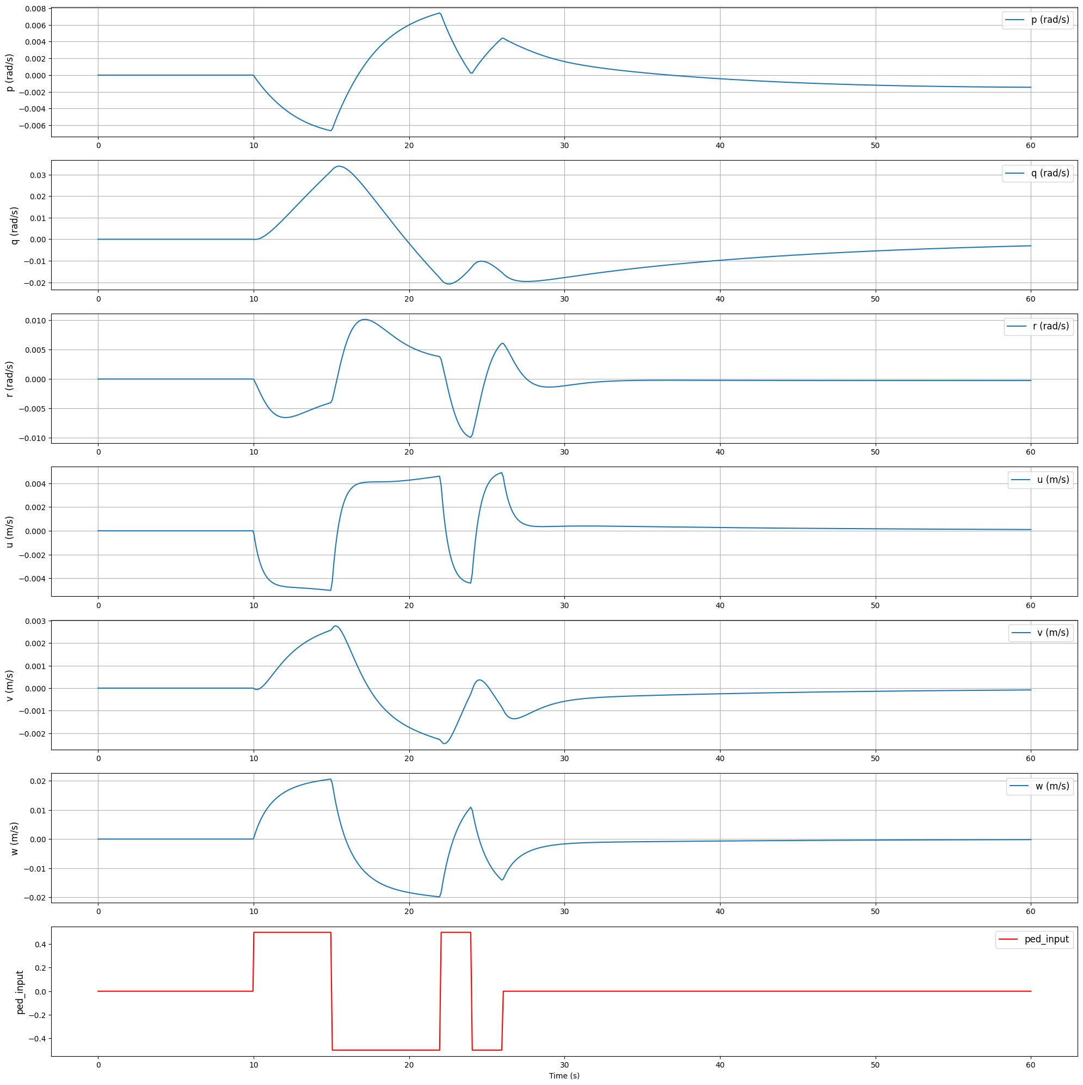
2-3-1-1 Pedal input

Slide 23
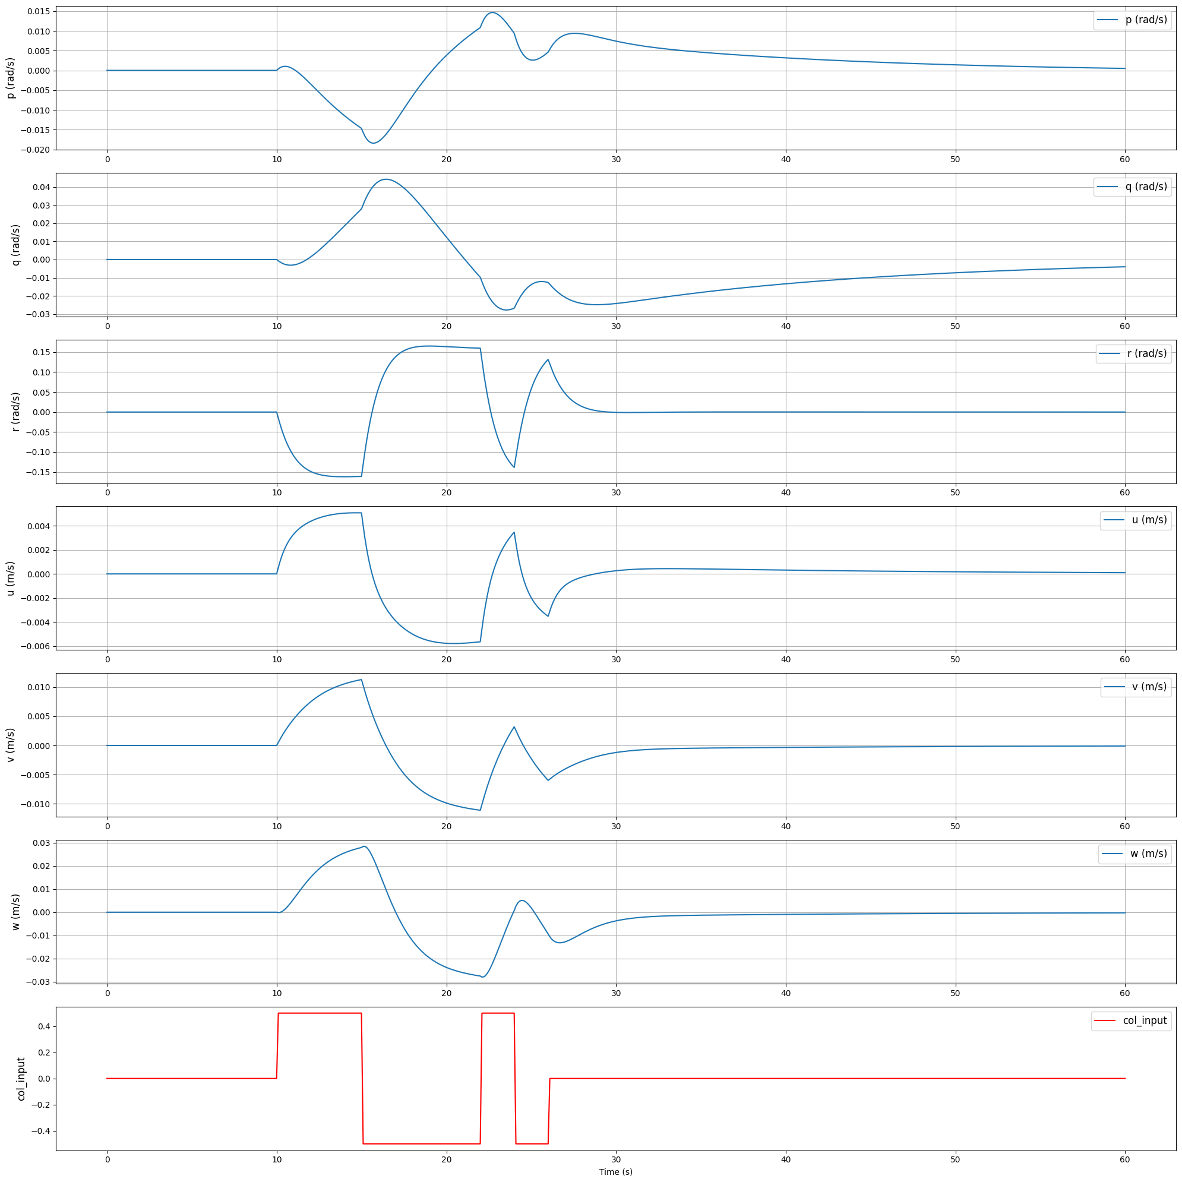
2-3-1-1 Collective input

Slide 24
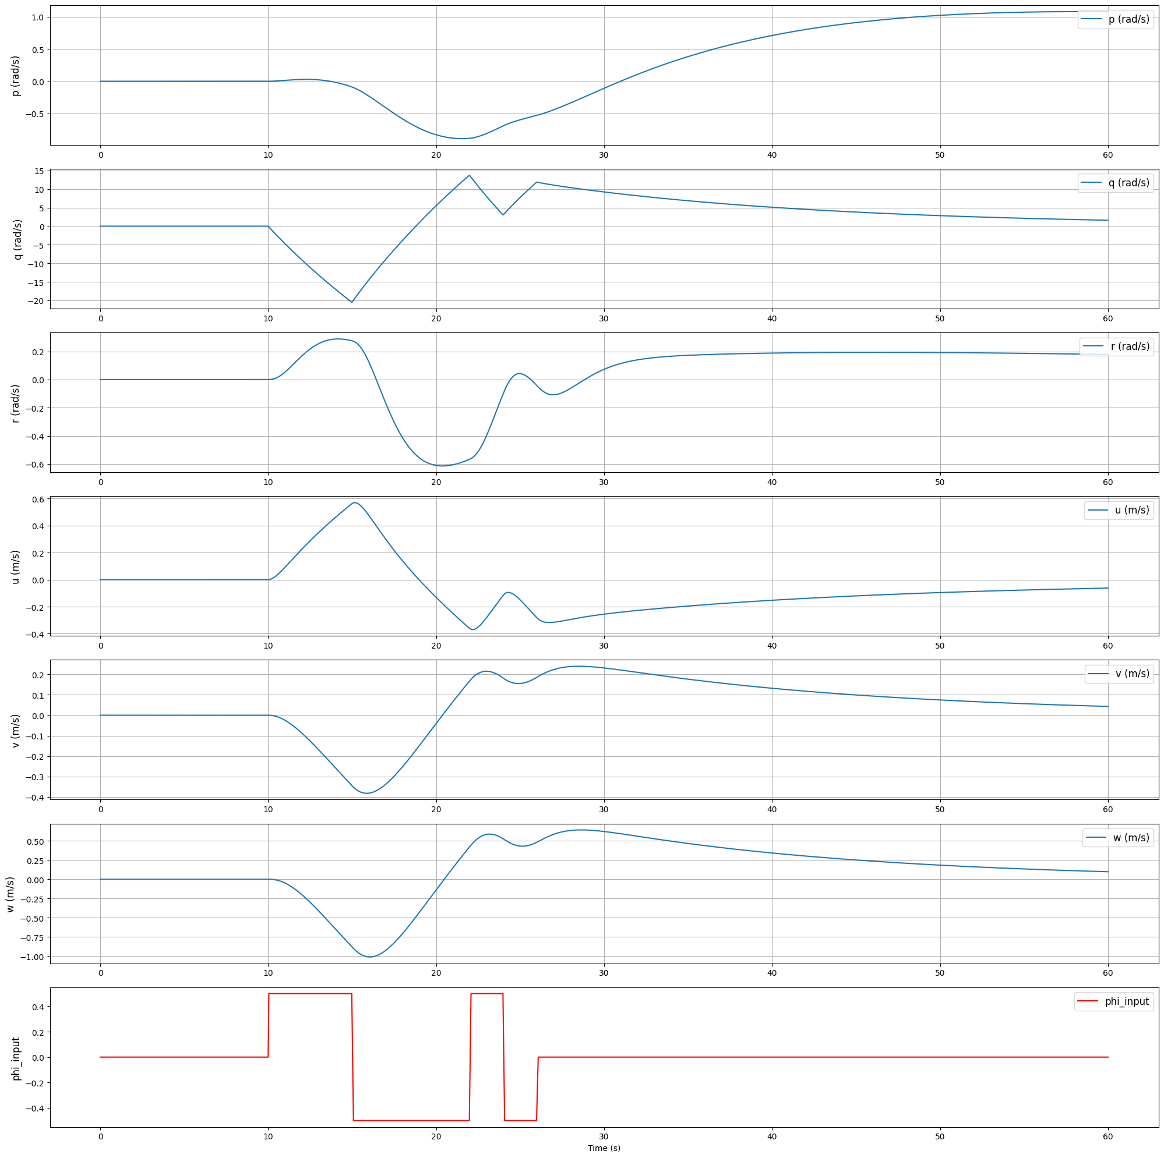

2-3-1-1 $φ$ input

Slide 25
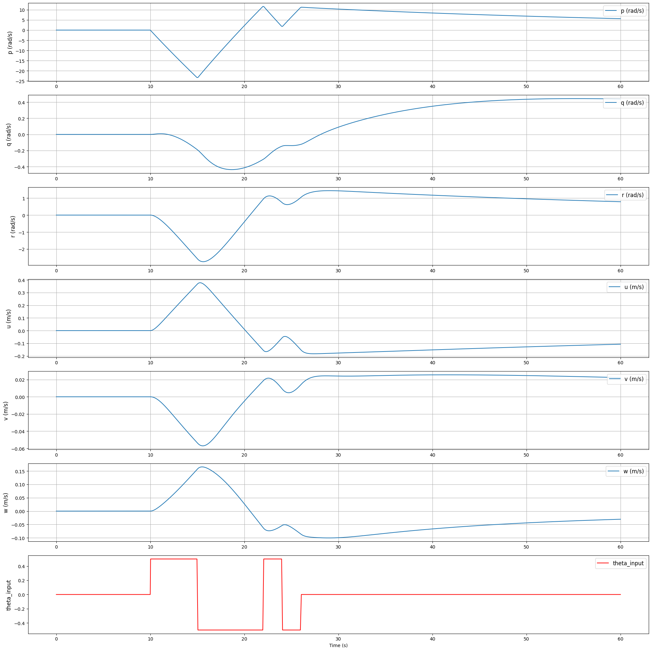

2-3-1-1 $θ$ input

Slide 26
Contents
Introduction
Boeing 747 Simulator
2.1 Data Explanation
2.2 ML Models Trained
2.3 Qualitative Results with Control Inputs
2.4 Quantitative Results
Bell 412 State Space model
3.1 Visualization of 2-3-1-1
Bell 205 Data Exploration
4.1 Filtering Experiment
4.2 Models Trained
4.3 Inference
Future Work and Questions.

Slide 27
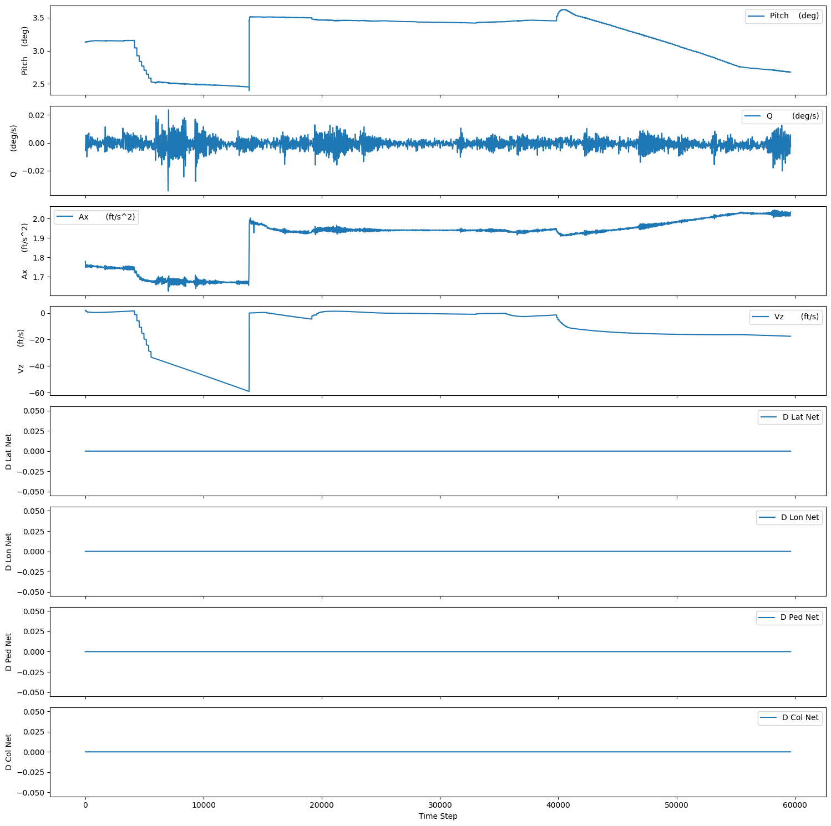

4. BELL 205 Data Exploration Total Data: Approx 1350 minutes (Assuming Sampling Frequency 100 Hz) Longitudinal State Variables Considered: $\left[A_{x}, V_{z}, Q, θ\right]$ Control Inputs Considered: $\left[D Lat,D Lon, D Ped, D Col\right]$

Slide 28
4. BELL 205 Data Exploration
TOTAL DATA POINTS = 6.80*10^6 | D Lat (net) | D Lon (net) | D Ped (net) | D Col (net) | Pitch (deg) | Q (deg/s) | Ax (ft/s^2) | Vz (ft/s)
mean | -0.331 | 1.500 | -0.175 | 4.182 | 2.618 | 0.178 | 1.518 | -0.064
std | 0.596 | 0.741 | 0.584 | 2.579 | 2.859 | 1.197 | 1.461 | 8.713
min | -3.389 | -1.802 | -2.981 | -0.317 | -18.404 | -15.655 | -5.441 | -211.325
max | 3.597 | 4.641 | 1.835 | 8.982 | 26.672 | 14.122 | 8.322 | 64.987

Slide 29

4.1 Filtering experiment
Butterworth Low Pass Filter
N=2: The order of the filter. A second-order filter (N=2).
Wn=0.1. Sampling rate is 100Hz, So $f_{n}=50Hz$, I am assuming cutoff frequency of 10Hz, So $W_{n}=f_{c}/f_{n}$ which is the normalized parameter.

Slide 30
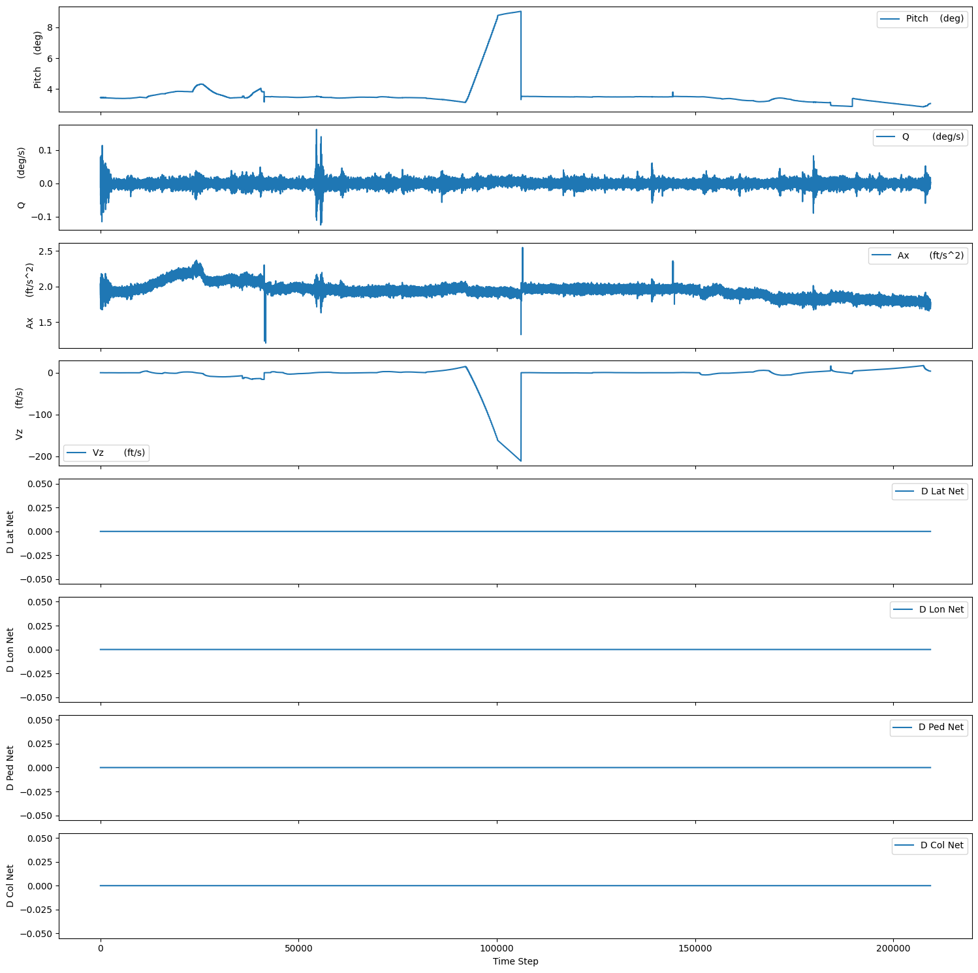
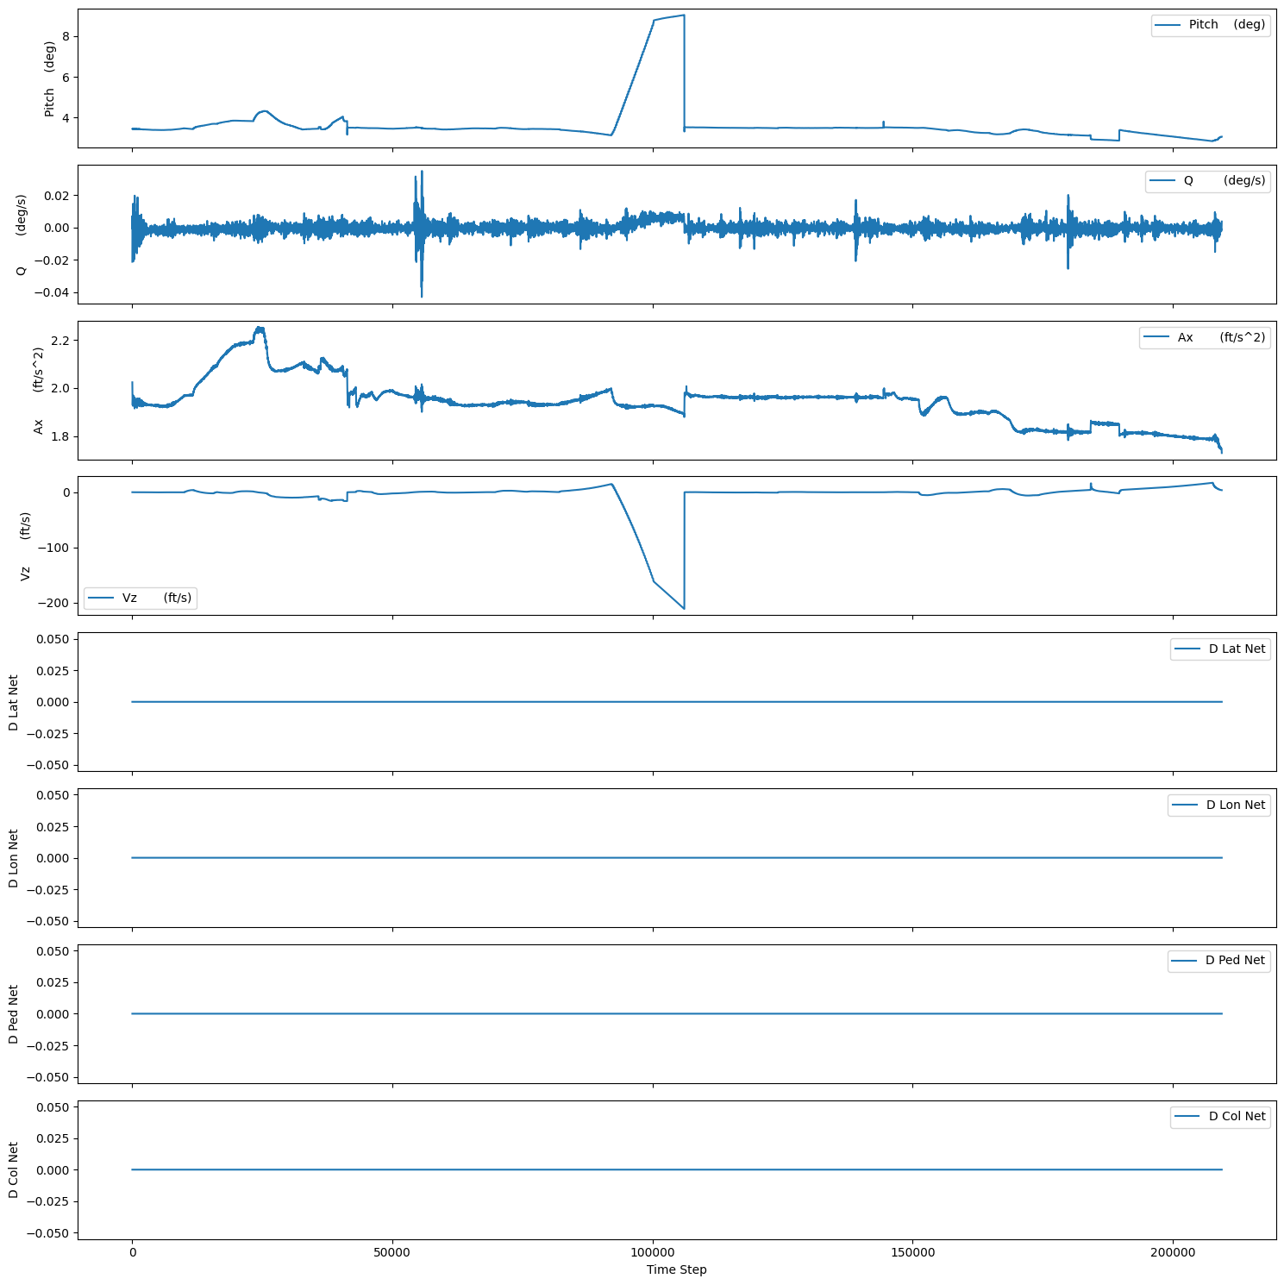
4.1 Filtering experiment

Slide 31
4.2 ML Models Trained
LSTM | MLP
Layers = 8, Hidden_size = 50, | Layers = 8, Hidden_size = 50,
Epochs = 500, batch_size = 512, lr = 0.005 (Reduce LR on plateau used) | Epochs = 500, batch_size = 512, lr = 10-3 (Reduce LR on plateau used)

Slide 32
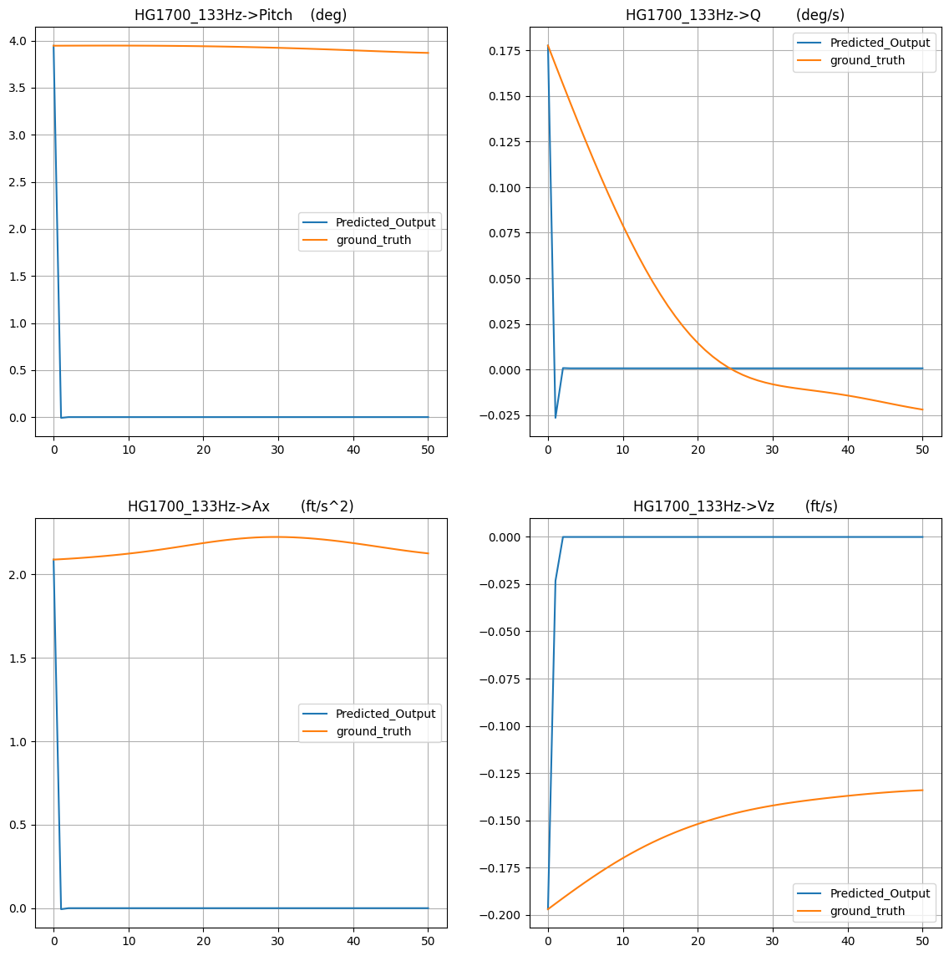
4.3 Results and Inference
- Both the models produced similar results
- Models are not capturing the dynamics due to noise

Slide 33
Contents
Introduction
Boeing 747 Simulator
2.1 Data Explanation
2.2 ML Models Trained
2.3 Qualitative Results with Control Inputs
2.4 Quantitative Results
Bell 412 State Space model
3.1 Visualization of 2-3-1-1
Bell 205 Data Exploration
4.1 Filtering Experiment
4.2 Models Trained
4.3 Inference
Future Work and Questions.

Slide 34
Future Work
Develop a generative model for BELL 205
Try Learning rate sweep in BELL 205
Develop a simple model that replicates state space model of BELL 412

Slide 35
Questions
Why is there phi and theta in state space control inputs for BELL 412?
What is the difference between Final Drive and D control input?

